Slide 1
USE OF ARTIFICIAL NEURAL NETWORKS TO IDENTIFY FAKE PROFILES
Under the guidance of : Presented by :
Mr.P.Durga Prasad A.Nikhil(4511-19-733-045)
Assistant Professor M.Nikitha(4511-19-733-019)
Dept of CSE,MGU,UCET R.Raju(4511-19-733-036)

Slide 2
CONTENTS
Abstract
Introduction
Existing system
-Disadvantages
Proposed system
-Advantages
System Requirements
System Architecture
Modules
Conclusion

Slide 3
Abstract
We use machine learning, namely an artificial neural network to determine what are the chances that Facebook friend request is authentic or not. We also outline the classes and libraries involved.
The social network, is a crucial part of our life is plagued by online impersonation and fake accounts.
In this project, we propose a model that could be used to classify an account is a fake or genuine, this is an automatic detection method, it can be applied easily by social networks which has millions of profiles, whose profiles cannot be examined manually.

Slide 4
Introduction
In 2017 Facebook reached a total population of 2.46 billion users making it the most popular choice of social media. Social media networks make revenues from the data provided by users.
The average user does not know that their rights are given up the moment they use the social media network's service. Social media companies have a lot to gain at the expense of the user. Every time a user shares a new location, new photos, likes, dislikes, and tag other users in content posted, Facebook makes revenue via advertisements and data.
In today's digital age, the ever-increasing dependency on computer technology has left the average citizen vulnerable to crimes such as data breaches and possible identity theft.

Slide 5
Existing System
The fake profile's contents typically have links that lead to an external website where the damage happens.
An unaware curious user clicking the bad link will damage their computer. The cost can be as simple as catching a virus to as bad as installing a rootkit turning the computer into a zombie. While Facebook has a rigorous screening to keep these fake accounts out, it only takes one fake profile to damage the computers of many

Slide 6
Disadvantages
Because of privacy issues the Facebook dataset is very limited and a lot of details are not made public.
Malicious users create fake profile to phish login information from unsuspecting users.
It damage our system and Our details are in the hand of unaware person.

Slide 7
Proposed System
In our solution, we use machine learning, namely an artificial neural network to determine what are the chances that a friend request is authentic or not.
We utilize Microsoft Excel to store old and new fake data profiles. The algorithm then stores the data in a data frame. This collection of data will be divided into a training set and a testing set. We would need a data set from the social media sites to train our model.
For the training set, the features that we use to determine a fake profile are Account age, Gender, User age, Link in the description, Number of messages sent out, Number of friend requests sent out, Entered location, Location by IP, Fake or Not

Slide 8
Advantages
The social networking sites are making our social lives better but nevertheless there are a lot of issues with using these social networking sites.
In this project we came up with a framework through which can detect a fake profile using ANN so that the social life of people become secured.

Slide 9
System Requirements
Hardware Requirements
Processor : intel core i3 or above
RAM : 4 GB(min)
Hard Disk: 128GB (min
Software requirements
Operating system : Windows 10 or above
Language : Python 3.7 or above

Slide 10
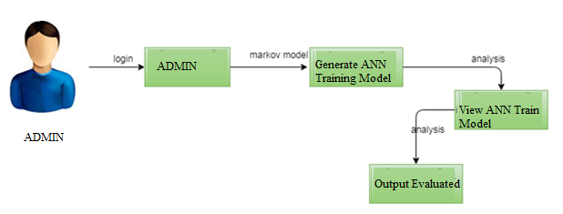
System Architecture

Slide 11
MODULES
1.Data Collection
2.Data Pre-processing
3. Model building
4.Prediction

Slide 12
Data Collection
Data collection, we are collected the data from kaggle https://www.kaggle.com/code/vikramb/fusers/data.com [1]
The collected data is in the csv file format.
Bellow we have a sample dataset with the attribute names as follows:
Account _Age, Gender, User_ Age, Link _Description, Status_Count, Friend_Count, Location, Location_IP, Status

Slide 13
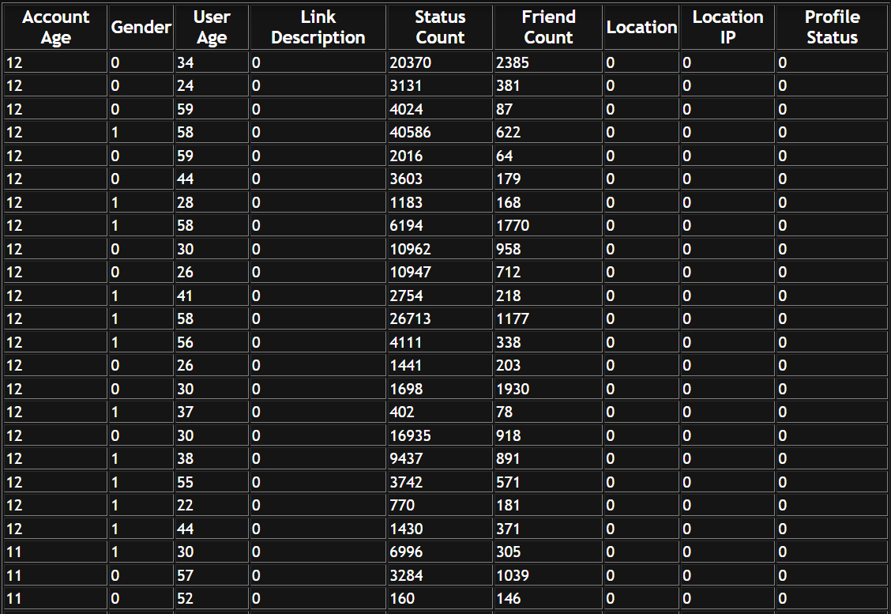

Slide 14
Data Pre-processing
The obtaining information must be pre-processed through multiple measures until entering every classifier to ensure the algorithm recognizes the data and creates the absolute best model.
Formatting and data cleaning are one of the pre-processing activities.
Data cleaning is used to manage the missing values of dataset.

Slide 15
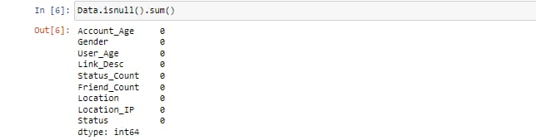

Slide 16
Model Building
We use machine learning, namely an artificial neural network to determine what are the chances that Facebook friend request is authentic or not. We also outline the classes and libraries involved
To demonstrate how to build a ANN neural network based image classifier, we shall build a 6 layer neural network that will identify and separate one image from other.
To predict image class multiple layers operate on each other to get best match layer and this process continues till no more improvement left..
We utilize Microsoft Excel to store old and new fake data profiles. The algorithm then stores the data in a data frame. This collection of data will be divided into a training set and a testing set. We would need a data set from the social media sites to train our model.

Slide 17
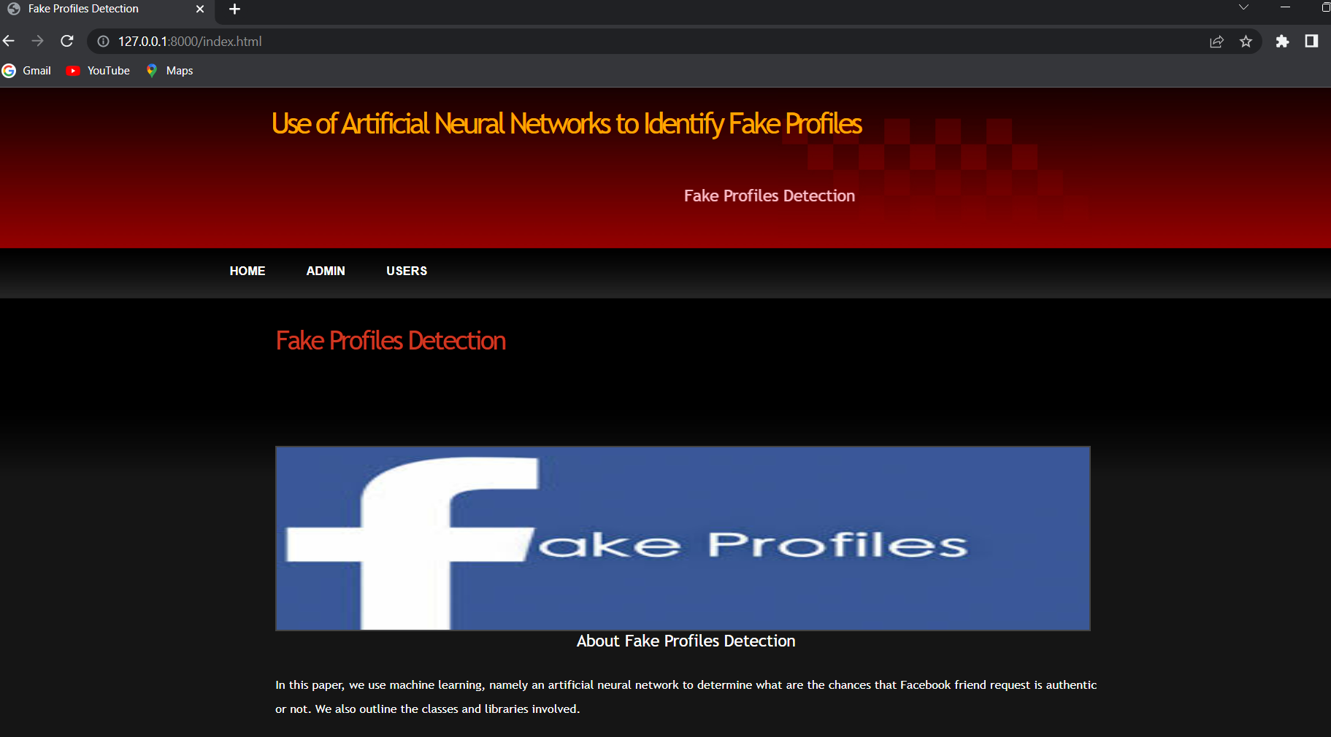

Slide 18
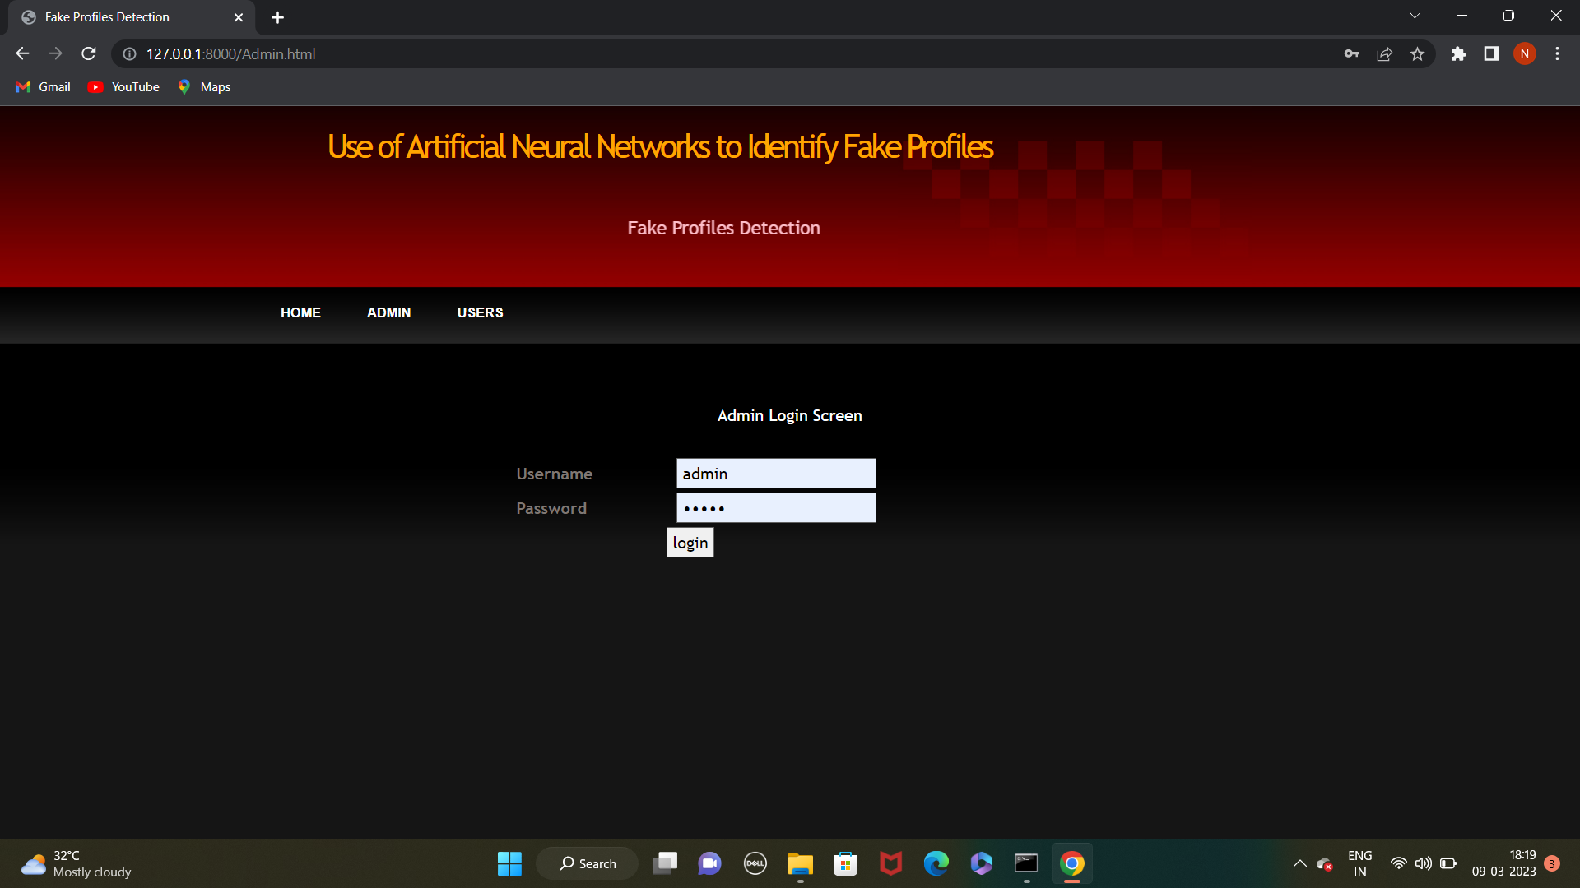
Admin will login to application by using username as ‘admin’ and password as ‘admin’ and then perform below actions

Slide 19
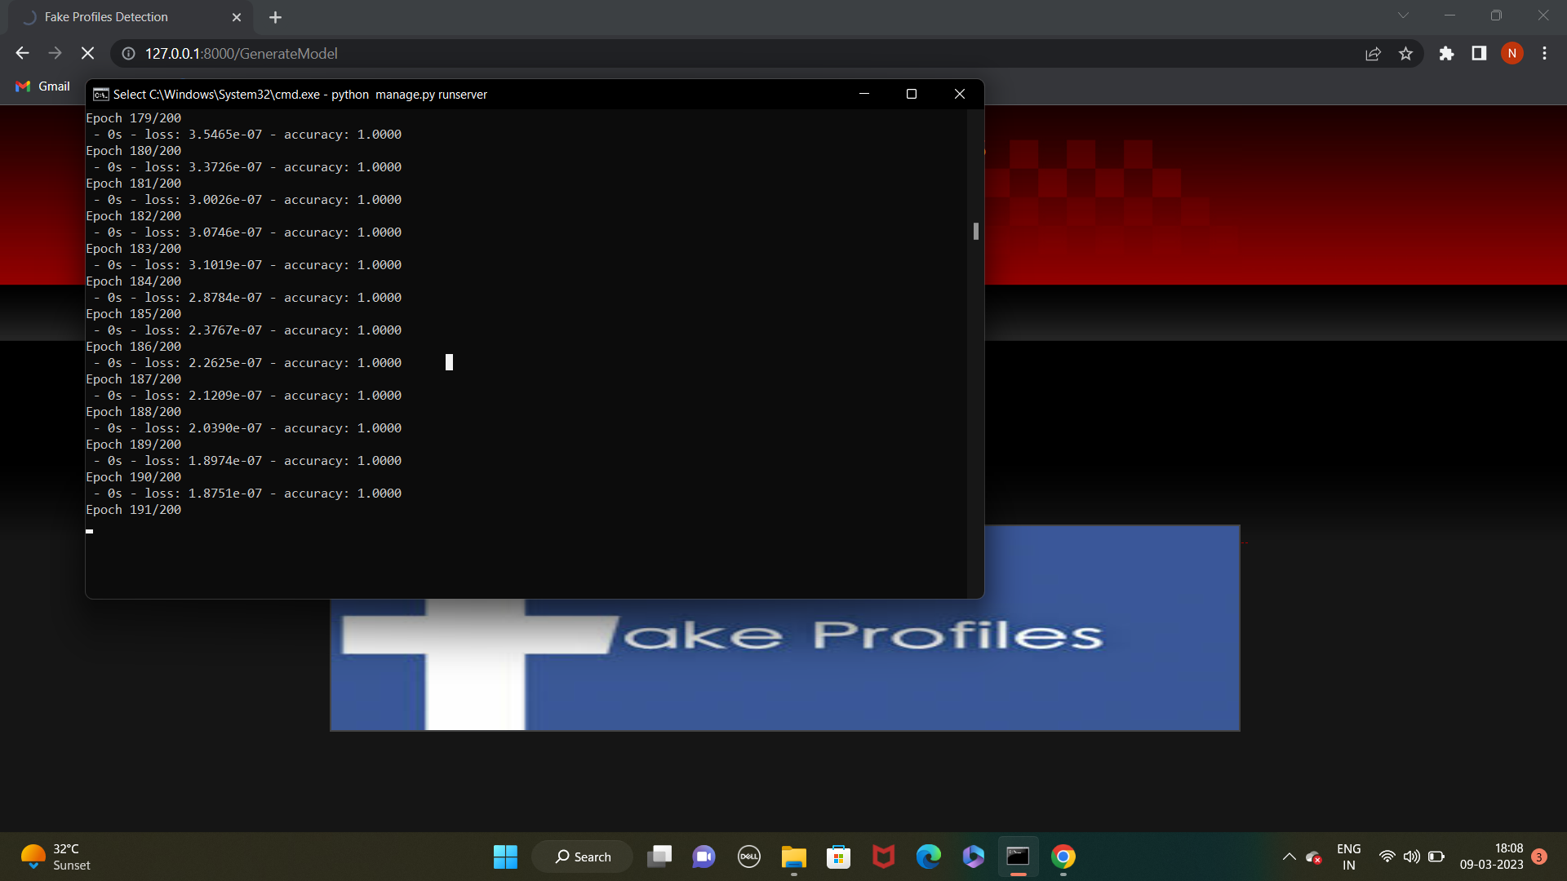
In the above black console we can see all ANN details.

Slide 20
Prediction
Artificial Neural Networks we are identifying whether given account details are from Genuine or Fake users. ANN algorithm will be trained with all previous users fake or genuine account data and then whenever we gave new test data then that ANN train model will be applied on new data to identify whether given new account details are from Genuine or Fake users.

Slide 21
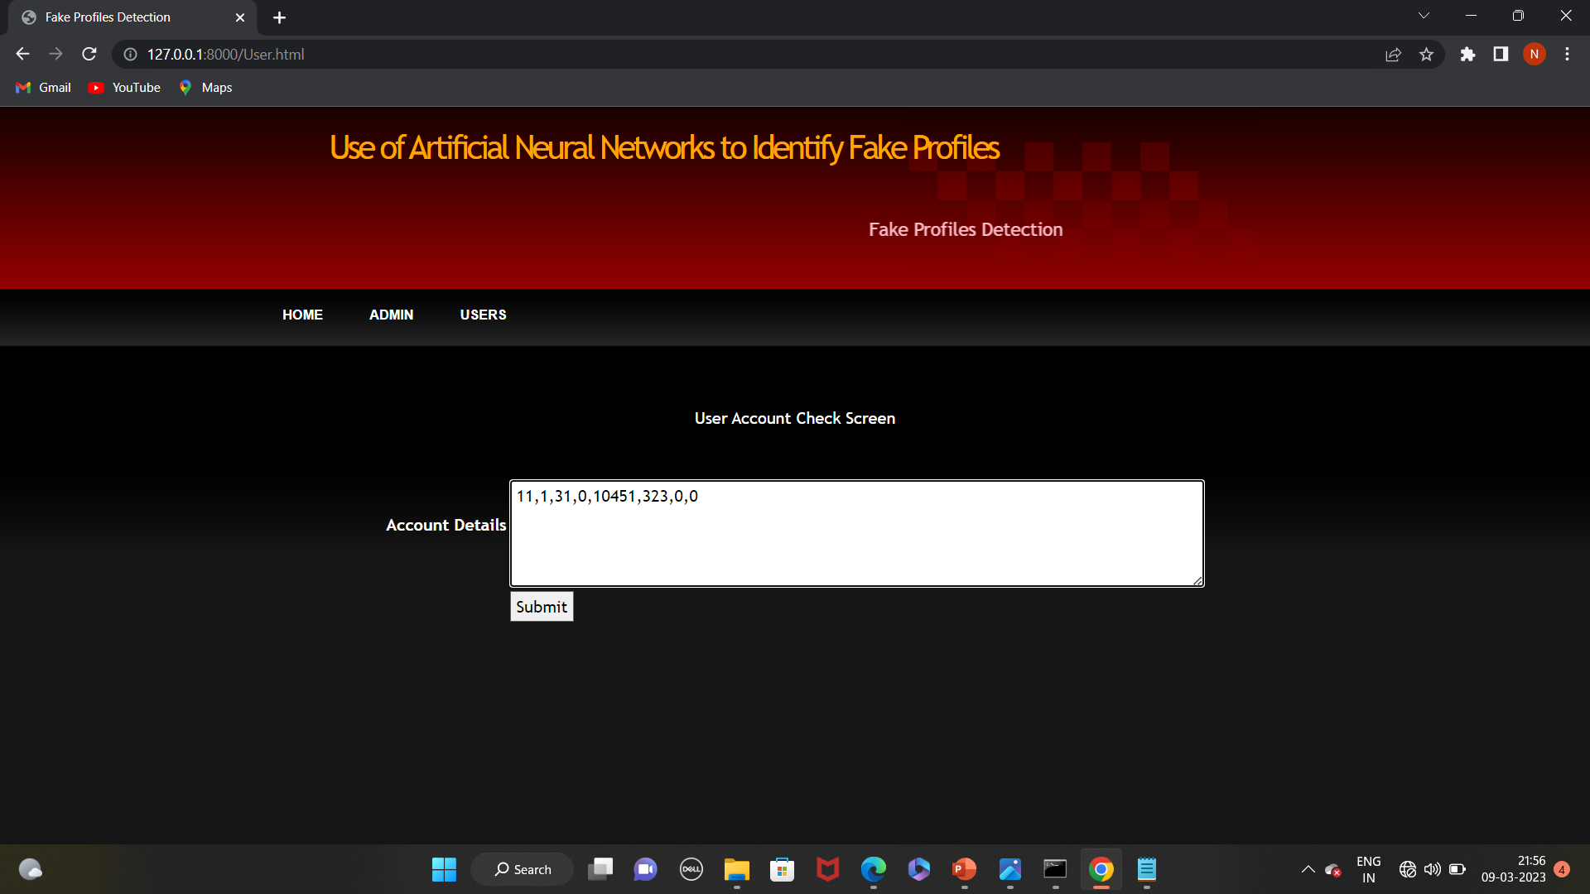

Slide 22
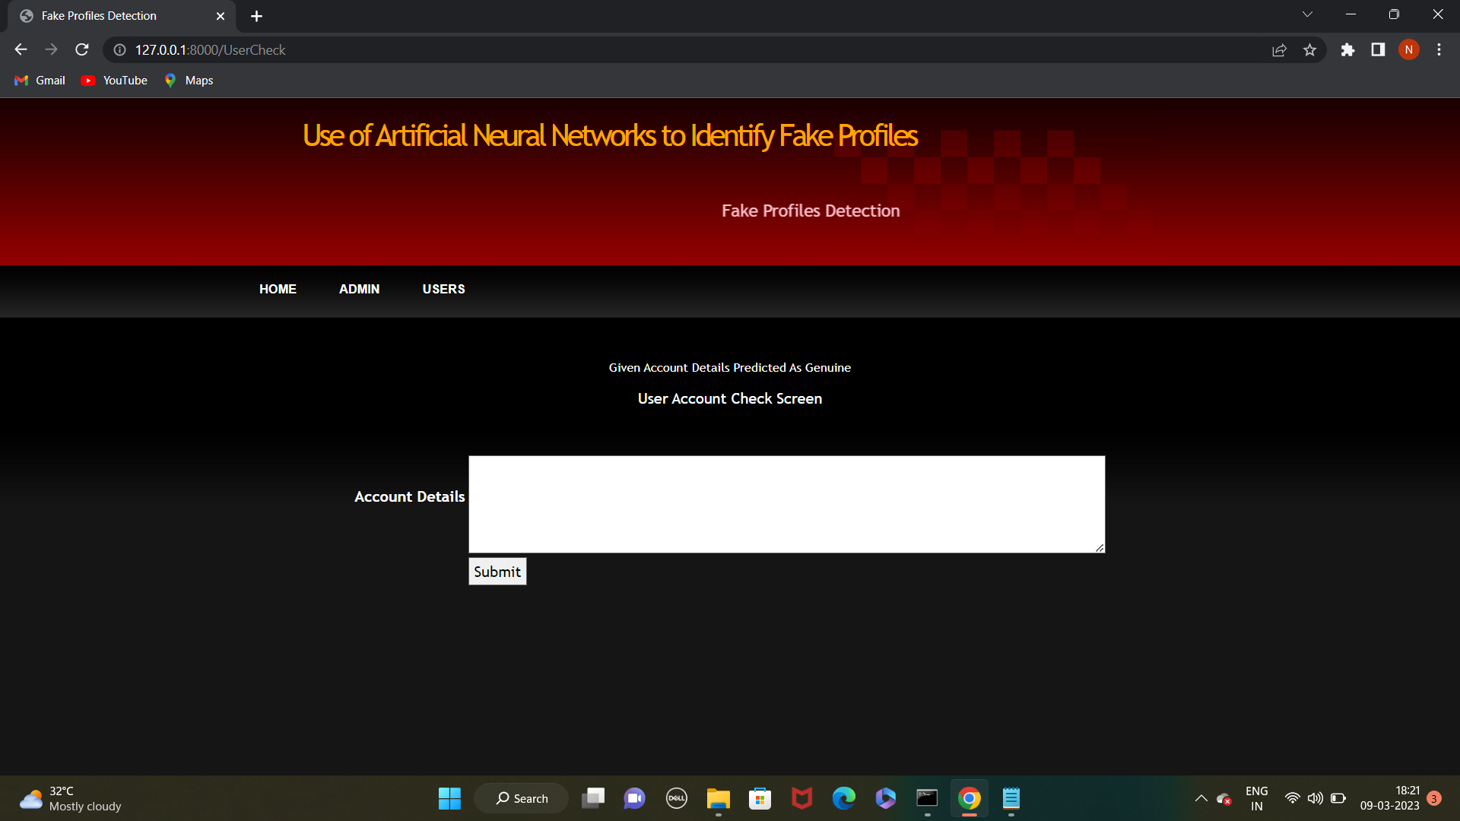

Slide 23
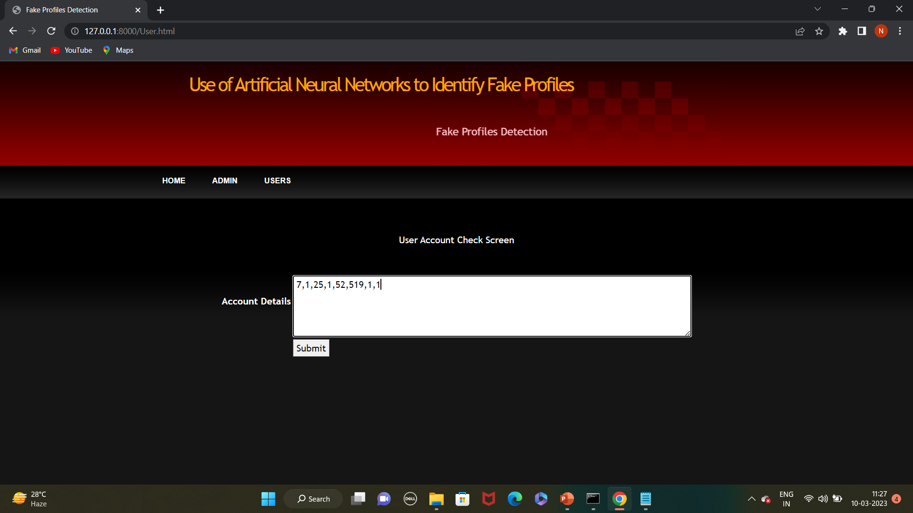

Slide 24
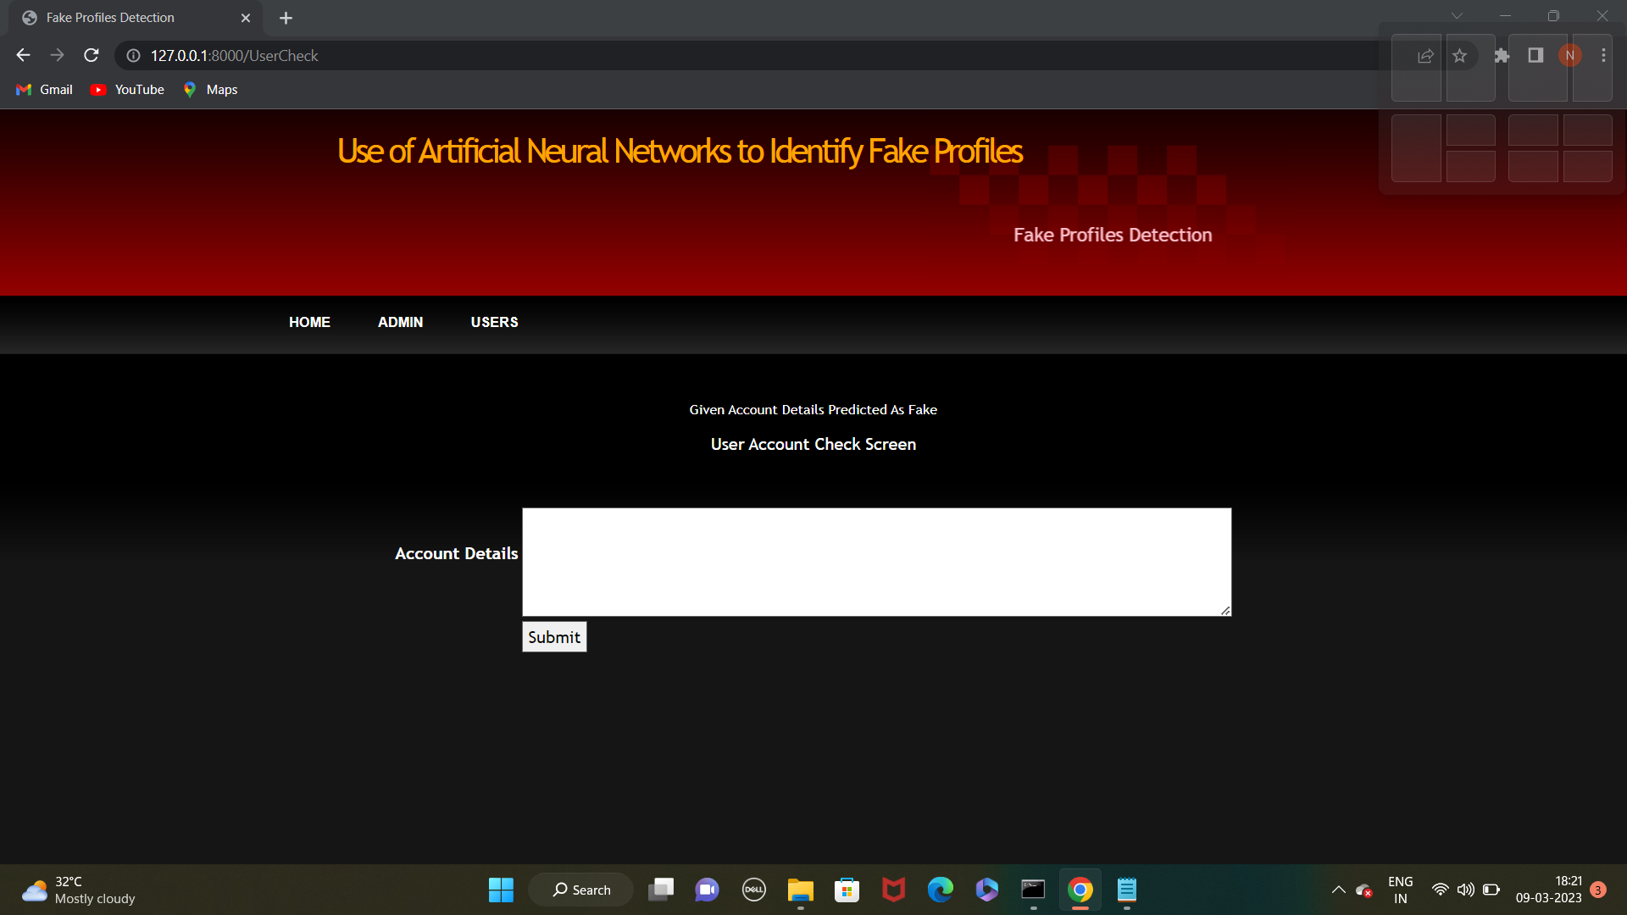

Slide 25
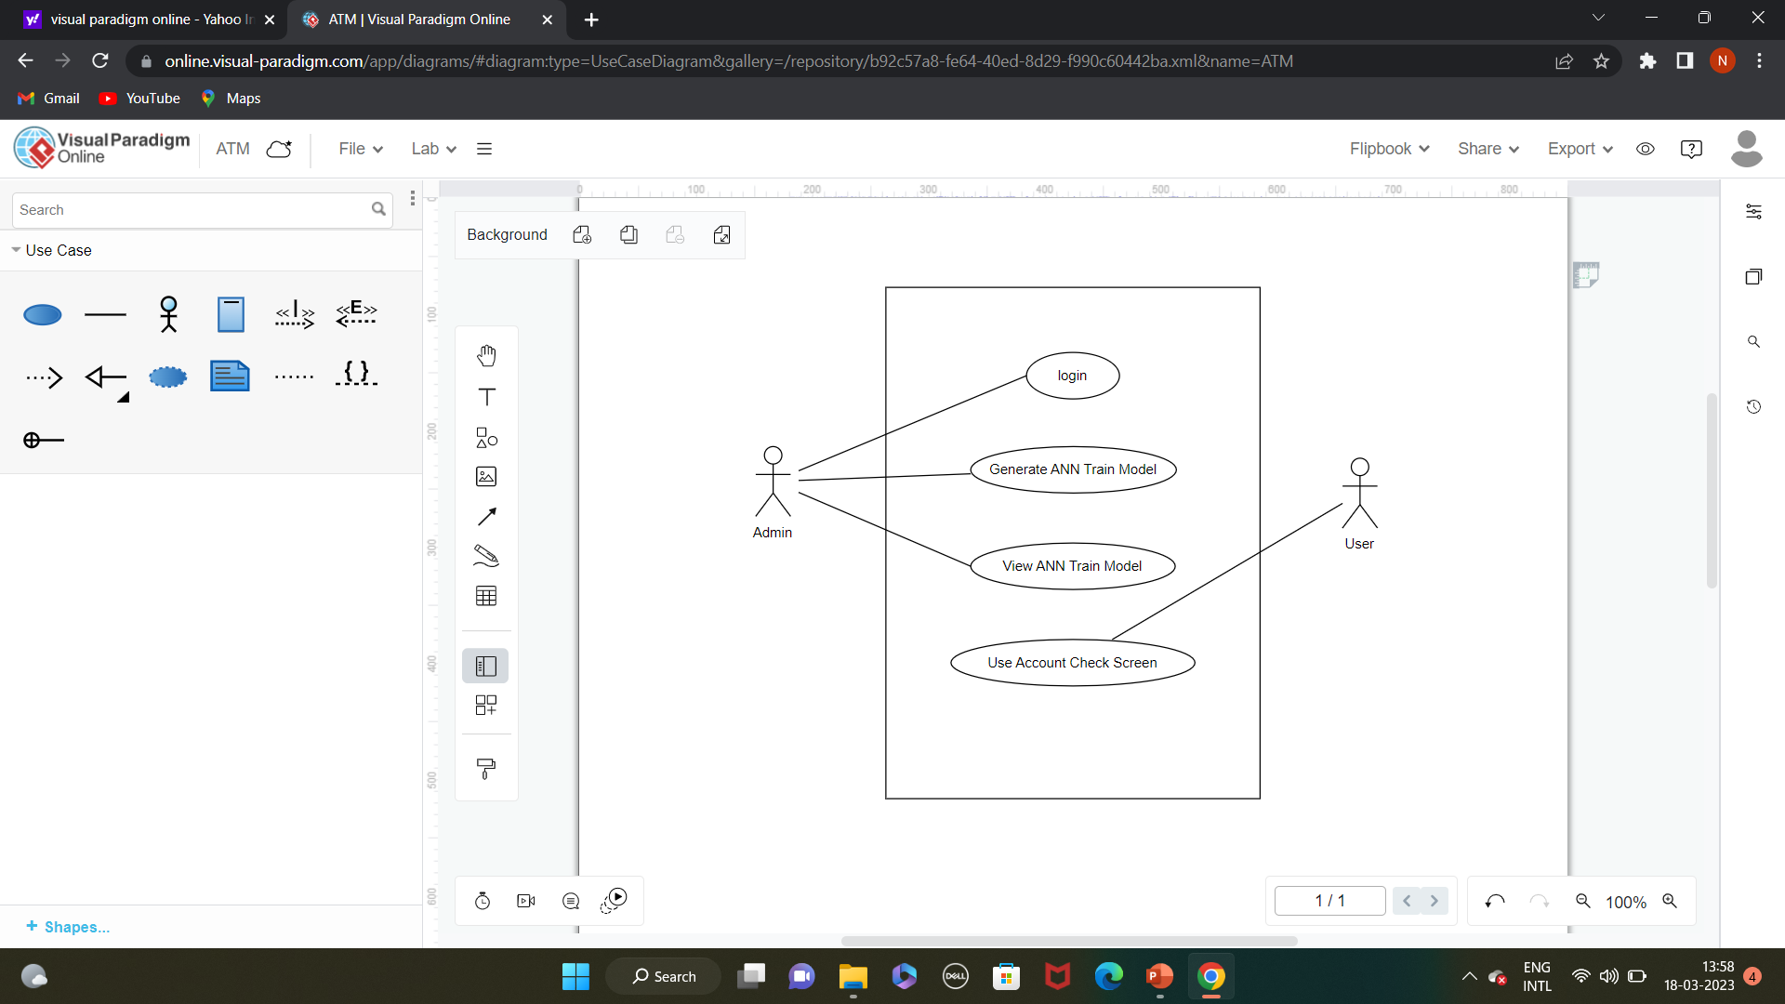
UML Diagrams
Use Case Diagram:

Slide 26
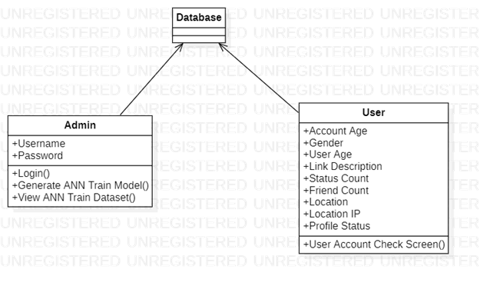
Class Diagram

Slide 27
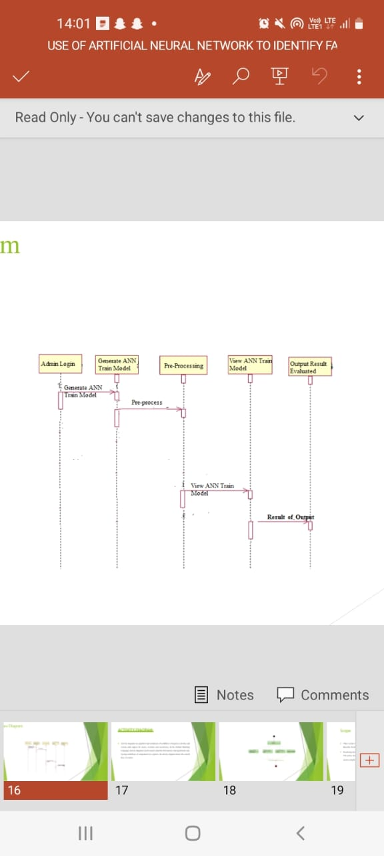
Sequence Diagram

Slide 28
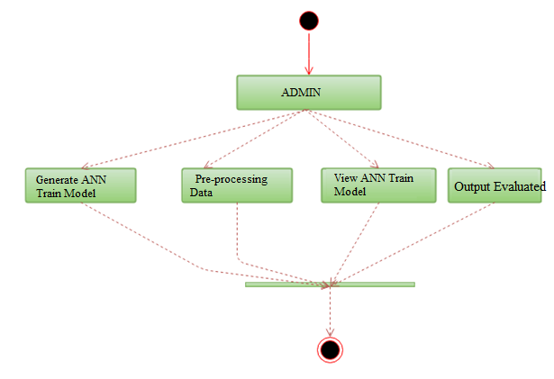
Activity Diagram

Slide 29
Future Scope
There seems to be a newsworthy issue involving social media networks getting hacked every day. Recently, Facebook had a data breach which affected about 50 million users [3].
Facebook provides a set of clearly defined provisions that explain what they do with the user's data [4]. The policy does very little to prevent the constant exploitation of security and privacy. Fake profiles seem to slip through Facebook's built-in security features

Slide 30
Conclusion
In this paper, we use machine learning, namely an artificial neural network to determine what are the chances that a friend request is authentic are or not. Each equation at each neuron (node) is put through a Sigmoid function. We use a training data set by Facebook or other social networks. This would allow the presented deep learning algorithm to learn the patterns of bot behavior by backpropagation, minimizing the final cost function and adjusting each neuron's weight and bias. In this paper, we outline the classes and libraries involved. We also discuss the sigmoid function and how are the weights determined and used. We also consider the parameters of the social network page which are the most important to our solution.

Slide 31
REFERENCES
1. For our project we have collected the data from kaggle with the following https://www.kaggle.com/code/vikramb/fusers/data.com
2. https://www.statista.com/topics/1164/socialnetworks/
3. https://www.cnbc.com/2018/01/31/facebookearnings-q4-2017- arpu.html
4. https://www.cnet.com/news/facebookbreach-affected-50-millionpeople/ [4] https://www.facebook.com/policy.php

Slide 32
Thank you

